Slide 1
Theme: Education Management
Problem Statement: Gamified Learning Management System
GROUP NAME: DEVBASH
Group Members:
Shivali Mhaske – 2023-B-04042003
Aditi Pardeshi – 2023-B-11072004
Pragya Jha – 2023-B-10052005A
Prajakta Raut- 2023-B-12082004

Slide 2

LearnLegal Gamified LMS is an interactive web-based learning platform designed to teach Child Laws using gamification techniques. It combines educational content with engaging quizzes, animations, badges, and a leaderboard to make learning fun, especially for children and young learners. This project aims to raise awareness about Child Rights and Laws through an intuitive and engaging experience. By integrating real-life scenarios into quizzes, learners can:
Understand legal concepts better,
Earn points and XP,
Unlock badges, and
Track progress on a live leaderboard.
The goal is to educate while keeping learners motivated and entertained.

Slide 3

Core Features of LearnLegal
Interactive Games
Rewards & Leaderboards
Focusing on rights, ethics, and responsibilities, these games keep children engaged.
Motivate young learners with rewards, badges and friendly competition.
Accessible Features
Audio learning and multilingual translation make the platform inclusive.

Slide 4
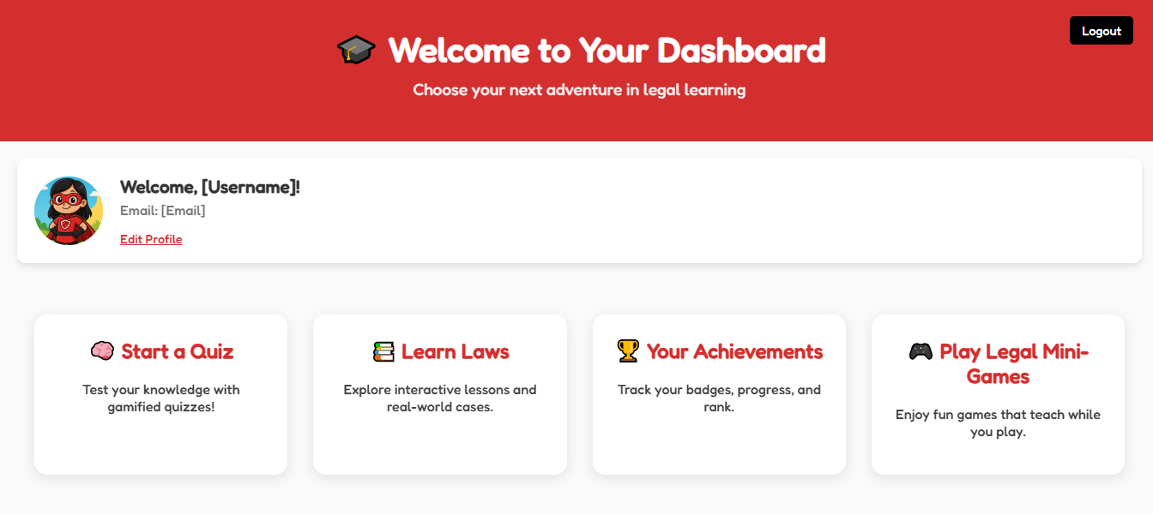

Slide 5
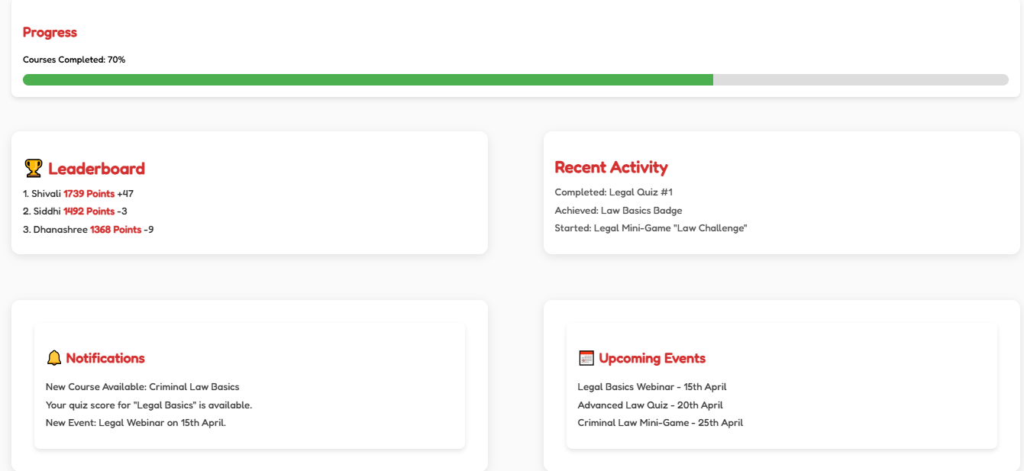
Tech Stack
Front-end
HTML5, CSS3, JavaScript ensure a dynamic user interface.
Back-end
Node.js with Express.js handles server-side logic efficiently.

Slide 6





Implementation Details for User Engagement
Unity Development
Unity creates immersive and engaging gaming experiences.
User-Friendly Design
Principles of inclusivity and accessibility guide design.
Testing and Feedback
Refine user experience through continuous testing.

Slide 7



Intuitive Platform Design
Legal Design
2
Principles applied for clarity and easy comprehension.
User-Centered
1
Designed to enhance engagement and effective learning.
Modular Structure
3
Ensures easy updates and addition of new content.

Slide 8




Realizing Educational Impact
Increased Literacy
Improved Skills
Social Awareness
Enhances legal literacy among young learners.
Hones decision-making through interactive scenarios.
Fosters a responsible, socially conscious generation.

Slide 9
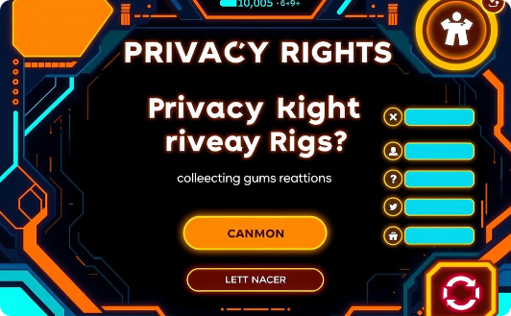
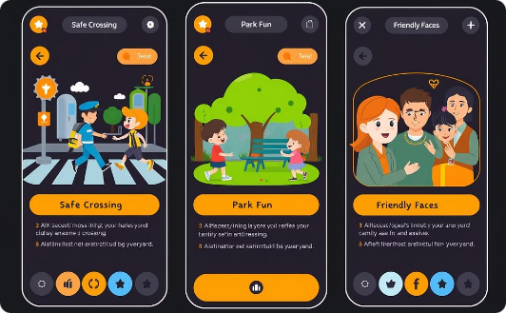
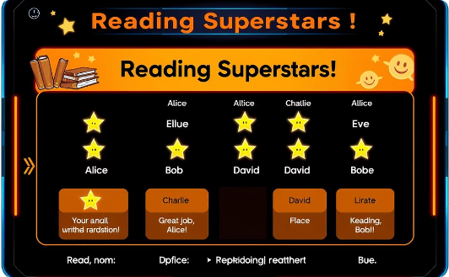
Explore the LearnLegal platform through these interactive demos.
Privacy Rights Quiz
Child Safety Story
Progress Leaderboard
An interactive game teaching children about their privacy.
A storytelling module on child safety protocols.
An example of leaderboards showing progress.

Slide 10
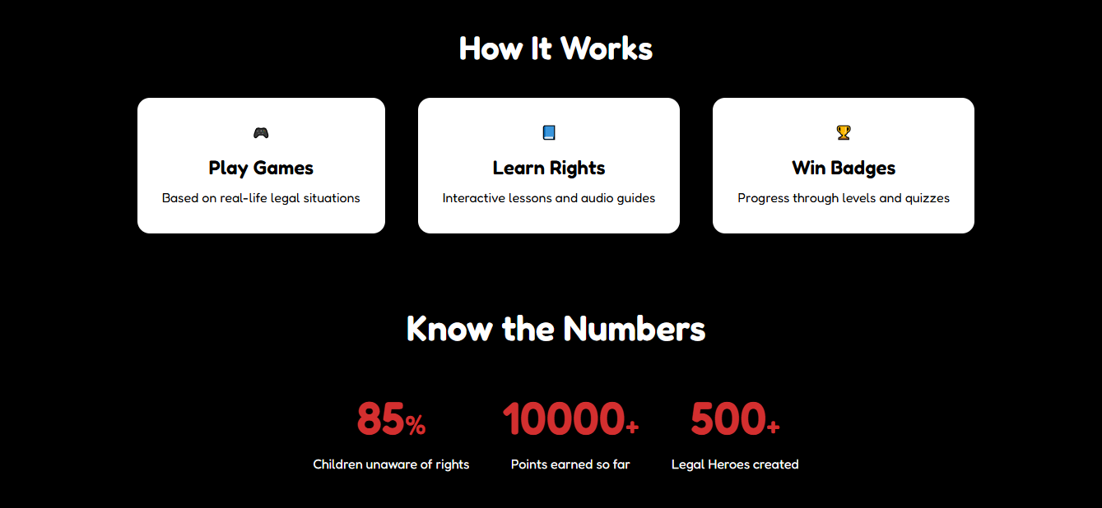
Thank You
Thank You

